Slide 1
Project 1 Group 2
Health Trends in Cities with High and Low Rates of Depression
Alice Nguyen
Kent Andrews
Esther Baumgartner

Slide 2
Our Dataset
CDC 500 Cities Data API
https://www.cdc.gov/places/
The 500 Cities Project was launched by the Centers for Disease Control and Prevention (CDC) in partnership with the Robert Wood Johnson Foundation (RWJF) and CDC Foundation.
This dataset includes the estimates for 27 measures of chronic disease related to unhealthy behaviors (5), health outcomes (13), and use of preventative services (9).

Slide 3
Research Questions to Answer
Is there a correlation between depression and other factors, such as binge drinking, lack of sleep, or no time for physical activity?
Which cities have the highest and lowest rates of depression?
What are the differences between the cities with the highest and lowest rates of depression?

Slide 4
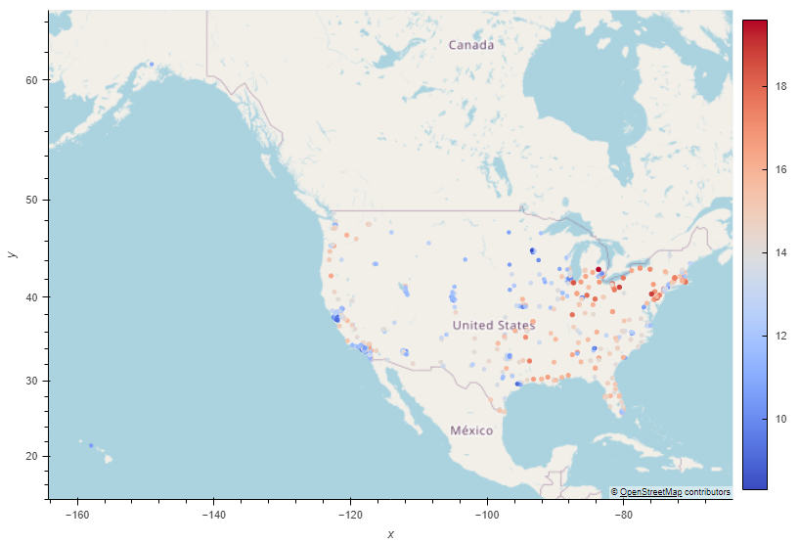
Rates of Depression from 500 Cities

Slide 5
Is There a Correlation Between Binge Drinking and Depression?

Slide 6
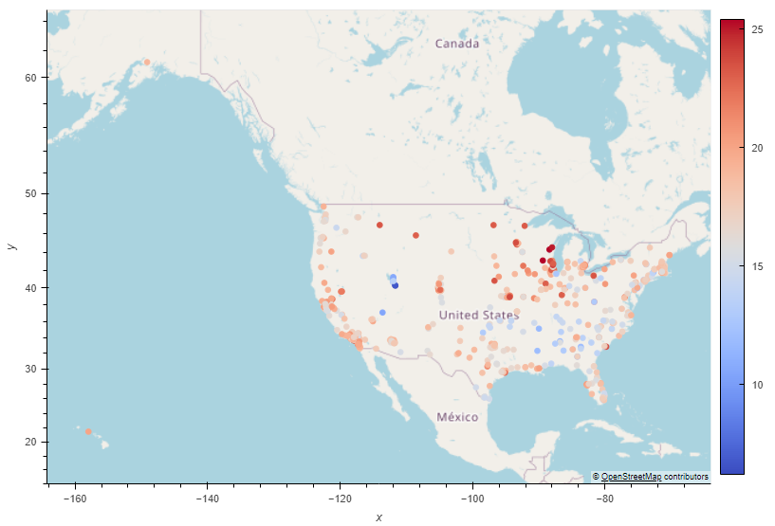
Rates of Binge Drinking for Each City

Slide 7
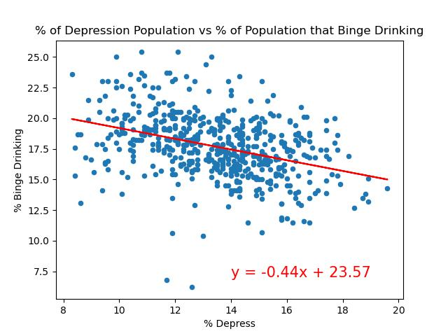
r-value is -0.36834
There is a low correlation between binge drinking and depression.

Slide 8
Is There a Correlation Between Depression and Lack of Sleep?

Slide 9

Rates of <7 Hours of Sleep for Each City

Slide 10
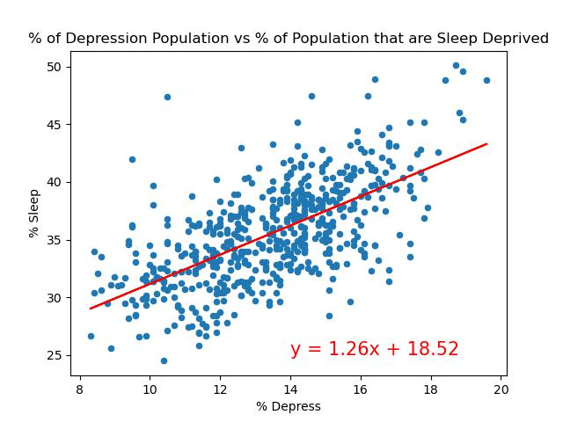
r-value is 0.63505
There is a fairly strong correlation between lack of sleep and depression.

Slide 11
Is There a Correlation Between Depression and Having no Time for Physical Activity?

Slide 12
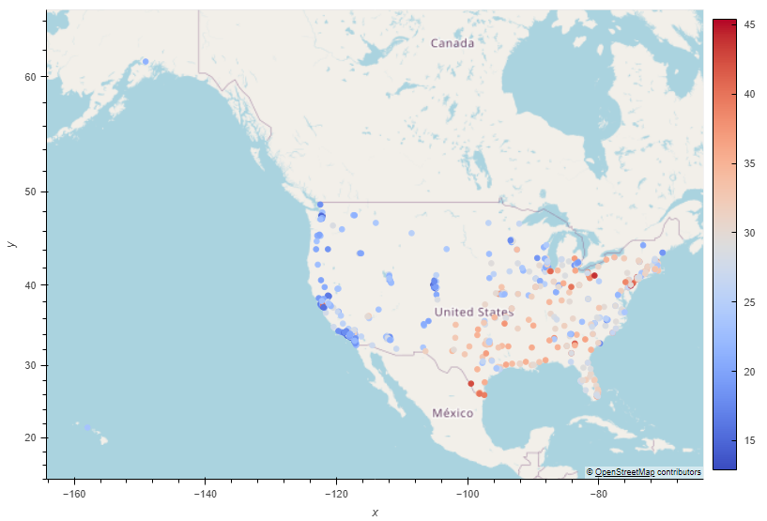
Rates of No Time for Physical Activity for Each City

Slide 13
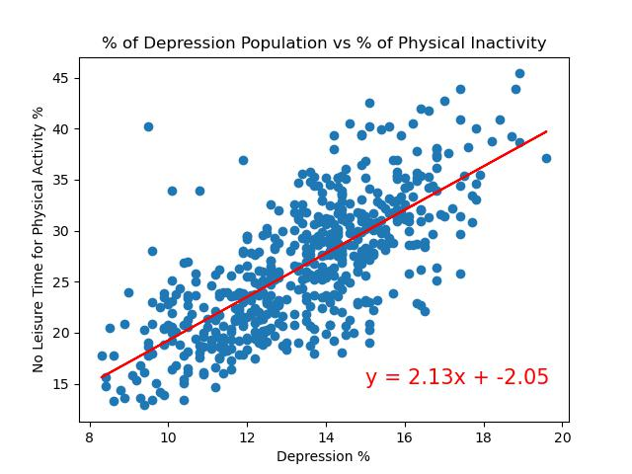
r-value is 0.72724
There is a strong correlation between having no leisure time for physical activity and depression.

Slide 14
Differences Between Most and Least Depressed Cities

Slide 15
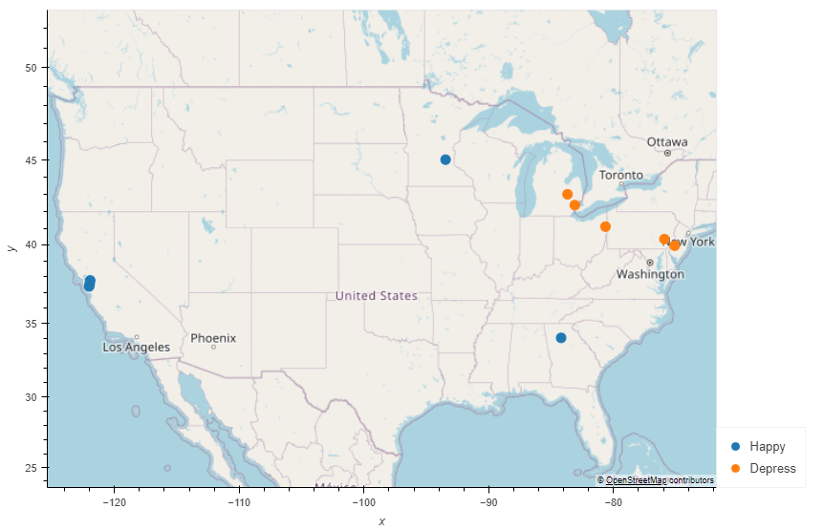
5 Cities with the Highest and Lowest Depression
Most Depressed Cities
Flint, Michigan
Reading, Pennsylvania
Camden, New Jersey
Youngstown, Ohio
Detroit, Michigan
Least Depressed Cities
Plymouth, Minnesota
Sunnyvale, California
Fremont, California
Johns Creek, Georgia
San Ramon, California

Slide 16
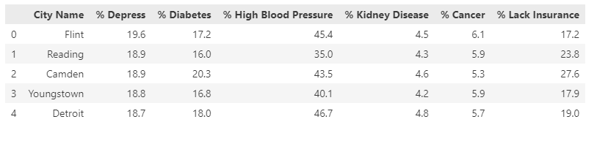
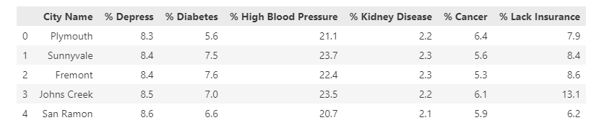
Health Data of the Most Depressed Cities vs Least Depressed Cities

Slide 17
States with Highest and Lowest Depression Rates

Slide 18
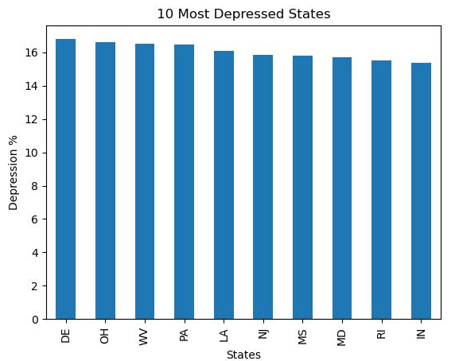
Delaware
Ohio
West Virginia
Pennsylvania
Louisiana
New Jersey
Mississippi
Maryland
Rhode Island
Indiana

Slide 19
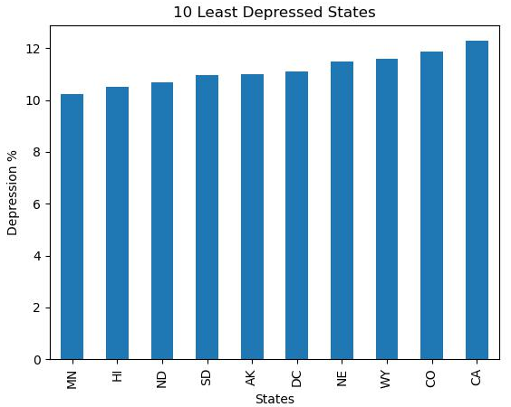
Minnesota!
Hawaii
North Dakota
South Dakota
Alaska
D.C.
Nebraska
Wyoming
Colorado
California

